Slide 1
Algorithm-2 design

Slide 2
A Finite State Machine (FSM) is used to describe the steps of algorithm 2.
The actions performed in each state are described in the following slides.
The hope is that state partitioning will help us divide the work and make it easier to design the control pulses.

Slide 3
input_count ==odd ?
S3_done
ML_training_done
~node_exists_in_AL
Input_ready
input_count == even ?
S0
S1
S2
S3
S4
S5
S6
S4_done
node_exists_in_AL
S6_done

Slide 4
S0
Idle state. The FSM waits for each new input to arrive. When input arrives, transition to S1.
Note: For associative memory, new inputs arrive in pairs (b,d) sequentially. We will need a global input counter accessible from all states to keep track of the number of inputs we have processed. The even/odd values of this counter distinguish between b/d type nodes.

Slide 5
S1
This is the state where we use algorithm 1 to train the memory layer (ML).
Controller issues a signal to read the image pattern x from memory. When the ML finishes training as per algorithm1 (i.e. the correct class for x is identified and a node identified within the class to represent x, weights adjusted etc.), it raises a “ML_training_done" indication. This triggers the transition to S2.
Note: S1 will probably have to fork off to another state machine to finish algorithm 1.

Slide 6
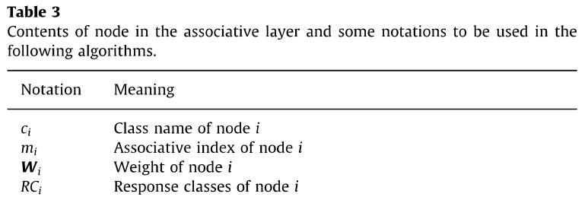
S2
Check if class label cx exists in the list of classes in the associative layer (AL). Each class is represented by a single node in the AL.
If no node b exists in this list with a class label cx, then enter S3 and insert a new node b.
Implementation: Use a memory. Suppose, we expect a maximum of 10 classes. Use a 4 bit address as your class label. The content of this address should be a data structure (verilog struct?) which has a valid bit, indicating that the class exists in the AL. Add additional bits to the data structure to represent all the needed information.
Additional bits needed: Refer to Table 3 in the paper. Use only the first 4 elements of the table. RCi will be an array, because there can be multiple response classes for each class.

Slide 7
S2..(continued)
When a new class label is presented, we check the memory with the class label as address. Check if the valid bit for the data at this address == 1. Else, we need to add a new node. So, transition to S3.
If node exists in the AL, transition to state S4.
Eg: addr = C_{x}
if (memory[addr].valid == 1)
next_state = S4; //update an existing ndoe
else
next_state = S3; // add a new node

Slide 8
S3
Insert a new node into the memory described in S2.
Use the class label as your address and the node struct as the data for this address.
When done, transition to S5
Addr = C_{x};
memory[addr].valid = 1;
memory[addr].mi = 0; // Associative index m_{b} (or m_{d}) = 0.
memory[addr].weight = node_value ; //Open: How is algorithm1 calculating node_value? Use the same method.

Slide 9
S4
Node exists in memory. i.e. memory[addr].valid == 1, where addr = class label.
Update the contents of this node.
Increment the associative index of the node only if it is a “b” type node and not a “d” type node.
This can be identified by looking at the current node count. If the node count is even, it is a “b” node.
memory[addr].mi = memory[addr].mi + 1 ; //incrementing associative index
memory[addr].RC array cannot be updated yet, because we don’t know the class label c_{y} for the response node (d).
Look up the memory layer (ML) from algorithm 1 to find the subnetwork of c_{x}. For each node in the subnetwork, extract the Mi (number of connections of each node or how many times it was the winner. Also denoted as M_{s1} in algorithm 1). Find the node with the max Mi. Use the weight of this "frequent winner" node (lets call it Wi)as the weight of the node b representing the class in the AL.
memory[addr].Wi = Wi
Store away the class label of b in a temporary storage, so that it can be used to make a connection with node d in S5.
Eg:
Temp_b = 4’b1110; // This temp_b gets updated every time we process a “b” type node.
Or
Temp_d = 4’b0100; // This temp_d gets updated every time we process a “d” type node.

Slide 10
S5
In this stage, we increment the total input counter. For associative memory, new inputs arrive in pairs (b,d) sequentially.
If the input we just processed was of type “b”, the input counter will now have an odd numbered value. If so, jump to S0 to wait for the paired input “d”.
If the input we just processed was of type “d”, the input counter will now have an even numbered value. If so, jump to S6, where we make a connection between b and d.
Note: even/odd detection is just checking for (bit 0 == 0)

Slide 11
S6
We make the connection between nodes b and d. Use the previously stored temp memory to retrieve class labels of cx and cy corresponding to b and d.
Iterate over all entries in the connection table. See if a pair (b,d) exists. If so, increment its weight.
Implementation: Use a lookup table. Use concatenation of the 4-bit values of c_{x} and c_{y} as a 8-bit key to look up the table. If a match is found, increment the weight corresponding to that 8-bit key.
Eg:
Temp_b = 4’b1110
Temp_d = 4’b0100
Hence key = 8’b11100100 = decimal 228
Connection_table[228] = Connection_table[228] + 1;
So a value of 0 indicates that no connection exists. A value > 0 indicates a connection (or “arrow”) between nodes b and d.

Slide 12
S6..(continued)
We now update memory[addr].RC array mentioned in S4.
This is where a response class is added for each node.
Since RC_{b}[m_{b}] = C_{d,}
memory[addr].RC[m_{b}] = C_{d}
Where addr = class label C_{b}

Slide 13
Components
Input counter. Should be a register which increments for each pulse. Size depends on the total number of inputs we plan to process.
Memory block to store each node in the AL. This is described in S2.
Connection table to store the connections like b→d. This is described in S6.
Temp_b, Temp_d to store away the class labels currently being processed.
Depending on which parts of the flow get implemented with memristors vs Verilog, we will need more components. The partitioning needs to be discussed!

